Slide 1
DATA base management system
Online Price Comparison Platform
Final Project Report – Group 10
Presented by:
Tanmay Itkelwar - txi220001@utdallas.edu
Karan Paresh Desai - kpd230001@utdallas.edu
Shivraj Daware - sxd220207@utdallas.edu
Utkarsh Mishra - uxm230003@utdallas.edu

Slide 2
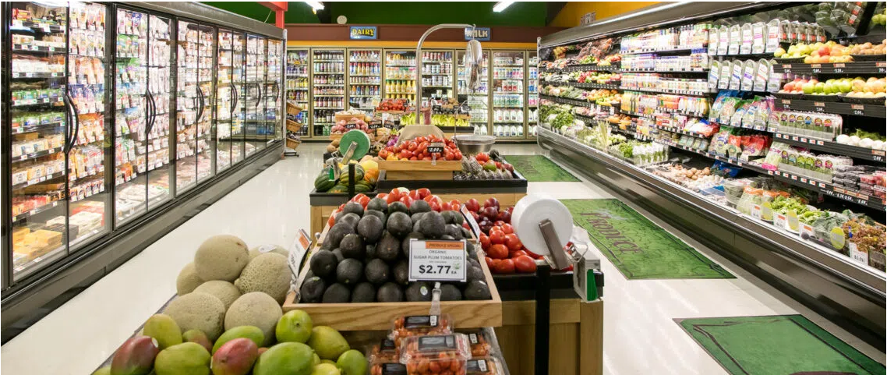
Introduction

Slide 3
System Requirements Identification
Information needs
Data of latest prices of the stores
GPS location
Hyper link of other websites

Slide 4
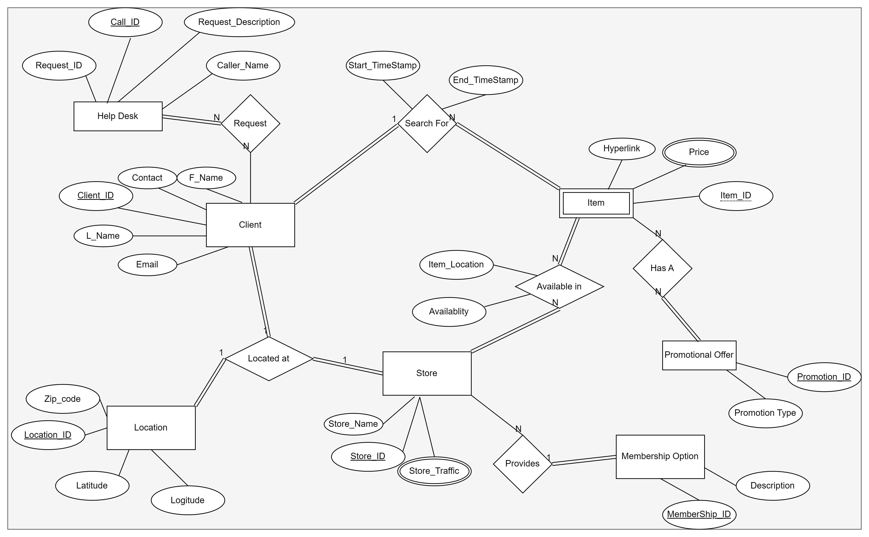
Conceptual Design

Slide 5
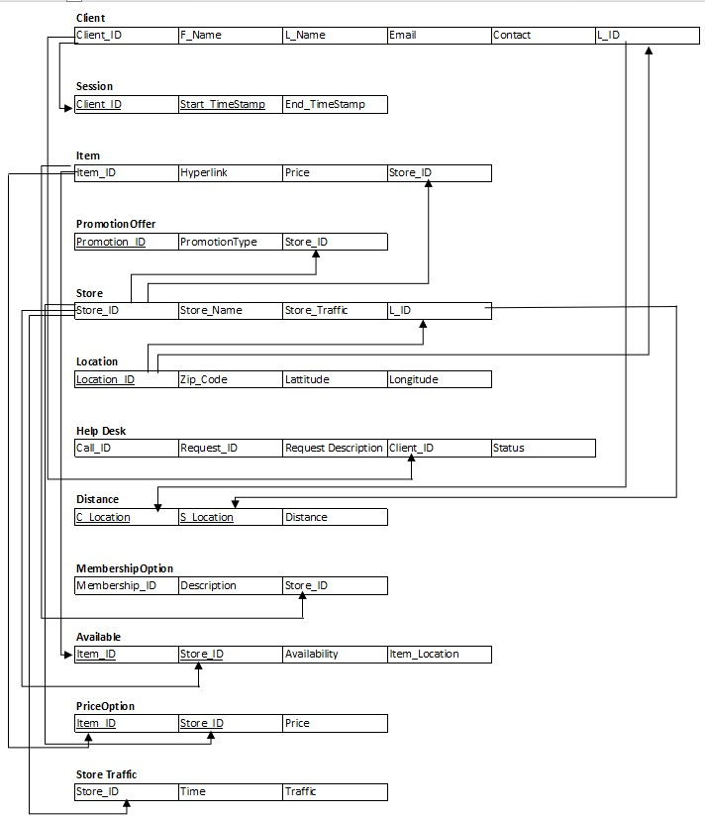
Relational Schema

Slide 6
Normalization
The item table was divided into two different tables.
The store table was divided into two different table
The availability table was merged into item table

Slide 7
Examples about Insertion Of Tables
Client:
CREATE TABLE Client (
Client_ID VARCHAR(20),
F_Name VARCHAR(20),
L_Name VARCHAR(20),
Email VARCHAR(40),
Contact BIGINT(11),
L_ID VARCHAR(20),
PRIMARY KEY (Client_ID),
FOREIGN KEY (L_ID) REFERENCES Location(Location_ID)
);
StoreTraffic:
CREATE TABLE StoreTraffic (
Store_ID VARCHAR(20),
Time_period Varchar(20),
Traffic VARCHAR(20),
PRIMARY KEY (Store_ID, Time_period),
FOREIGN KEY (Store_ID) REFERENCES Store(Store_ID)
);
Store:
CREATE TABLE Store (
Store_ID VARCHAR(20),
Store_Name VARCHAR(20),
Store_Timings varchar(20),
PRIMARY KEY (Store_ID)
);

Slide 8
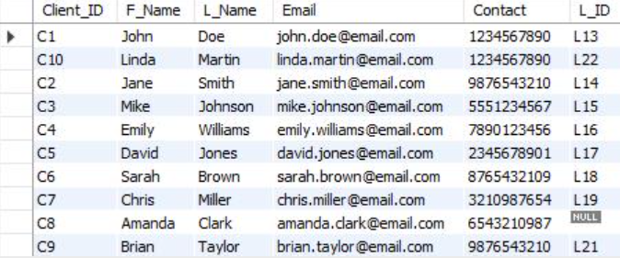
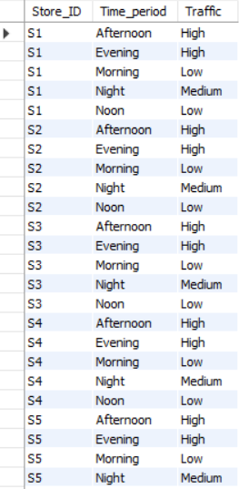
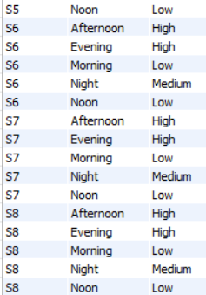
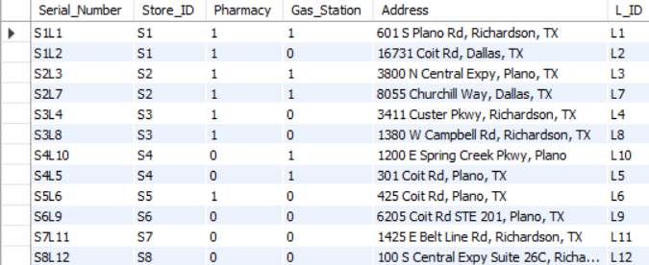
Insertion Of Table Client
Insertion Of Table StoreTraffic
Insertion Of Table Store_Details

Slide 9
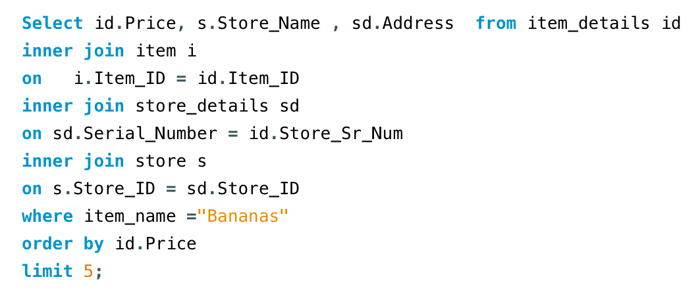
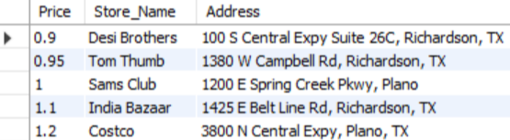
Query Scenario Design
Q.1) Show 5 lowest prices, the store name and their address for comparison for bananas.

Slide 10
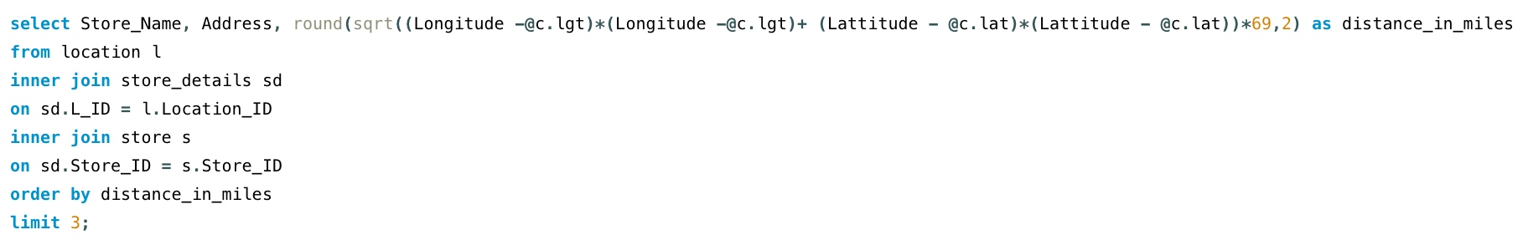
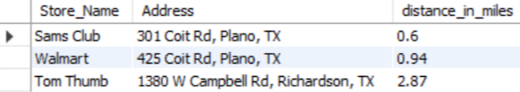
Q.2) Show first 3 outlets near client with Client_id = “C5”

Slide 11
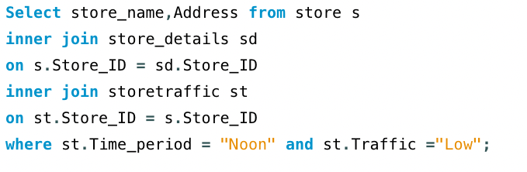
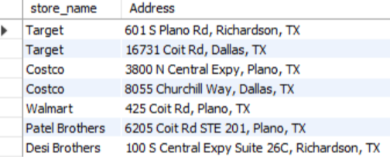
Q.3) List all the store names with addresses where store traffic is low in the noon.

Slide 12
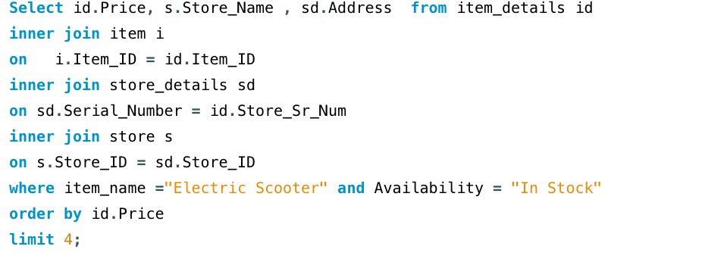
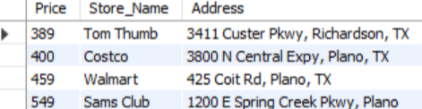
Q.4) Show 4 store names and addresses where the price for “Electric Scooters” which is in stock and is lowest.

Slide 13
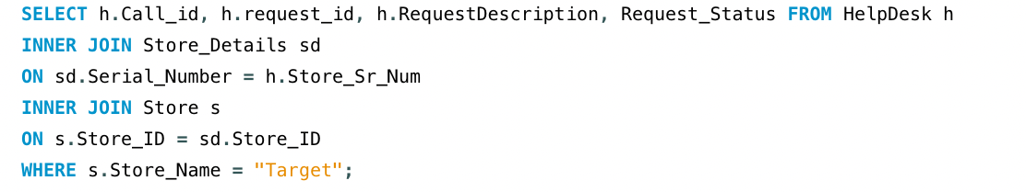
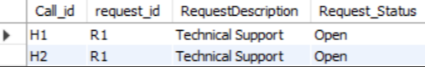
Q.5) List Call ID, Request ID, Description and Status of all the Request by target store

Slide 14
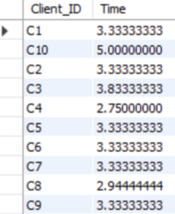
Q.6) Show what is the average time each client spends searching for products on the application.

Slide 15
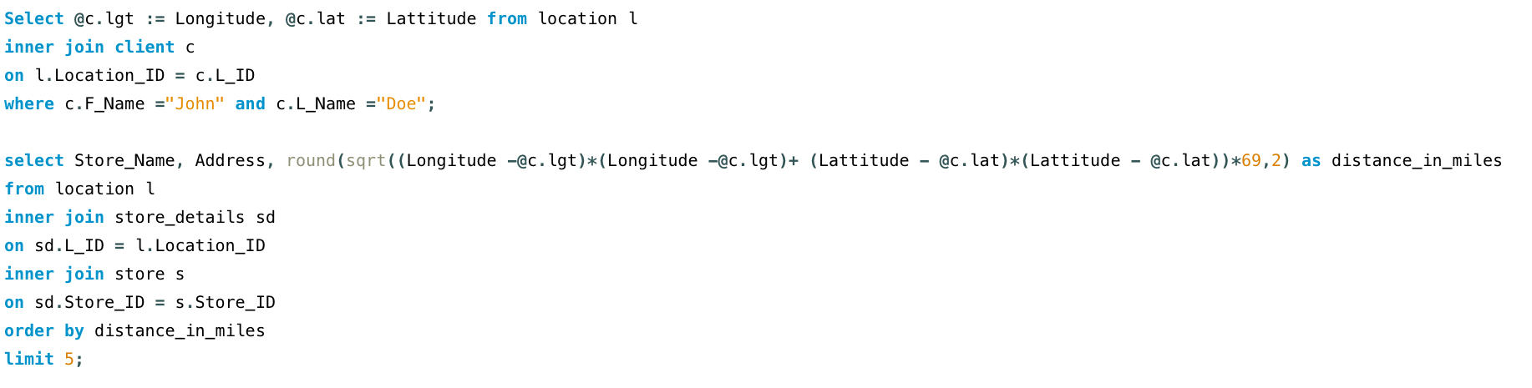
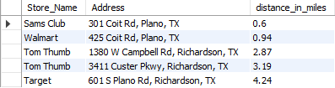
Q.7) Show the nearest 5 store locations for the client with the client name “John Doe”.

Slide 16
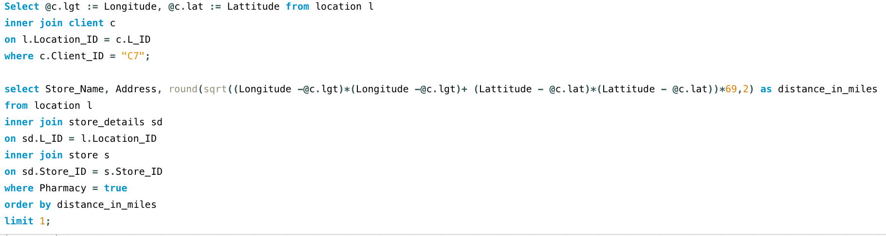
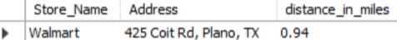
Q.8) Show the nearest store with Pharmacy for Client “C7”.

Slide 17


Slide 18


